Slide 1
Boggle Game (Algorithms and Data Structures)

Slide 2
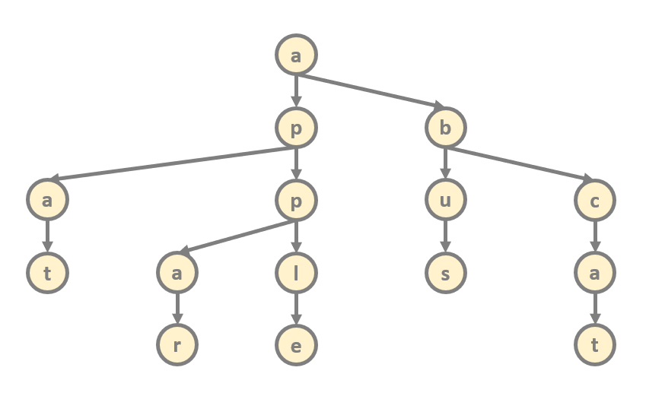
Boggle Game
A
C
Z
U
E
R
A
C
A
we need to check whether a character
sequence is a valid word or not
valid words are stored in a trie so we can check
It in O(m) running time
this is the boggle table
with the cells (letters)

Slide 3
Boggle Game
if the actual cell has i row index and
j column index then
(i+1, j) right neighbor
(i-1, j) left neighbor
(i, j+1) neighbor below
(i, j-1) neighbor above
A
C
Z
U
E
R
A
C
A

Slide 4
Boggle Game
A
C
Z
U
E
R
A
C
A

Slide 5
Boggle Game
A
C
Z
U
E
R
A
C
A
”C”

Slide 6
Boggle Game
A
C
Z
U
E
R
A
C
A
”CE”

Slide 7
Boggle Game
A
C
Z
U
E
R
A
C
A
”CEU”

Slide 8
Boggle Game
A
C
Z
U
E
R
A
C
A
”CEUA”

Slide 9
Boggle Game
A
C
Z
BACKTRACKING
we go back to the previous
state and try another possible
state instead
U
E
R
A
C
A
”CEUA”

Slide 10
Boggle Game
A
C
Z
U
E
R
A
C
A
”CEU”

Slide 11
Boggle Game
A
C
Z
U
E
R
A
C
A
”CEUA”

